Slide 1
Patients’ Physical Restraints Reduction Analysis Using Statistical Process Control (XmR) Chart
By Khatuna Kurdovanidze
Last edited 17/02/2024

Slide 2
Project Goal:
Monitor whether the percentage of patients subjected to physical restraints improving, declining, or not changing (using Statistical Process Control charts).
This will help us to:
Identify when the process is out of control and an intervention is needed.
Implement some follow-up interventions so the improvement lasts longer or forever.

Slide 3
How to use SPC charts for quality improvement:
A control chart helps one record data and lets you see when an unusual event, such as a very high or low observation compared with "typical" process performance, occurs.
In other words, control charts attempt to find the difference between two types of process variation:
Common cause variation, which will always be present in the process.
Special cause variation, which comes from external sources and indicates that the process is out of statistical control.
Various tests can help determine when an out-of-control event has occurred.

Slide 4
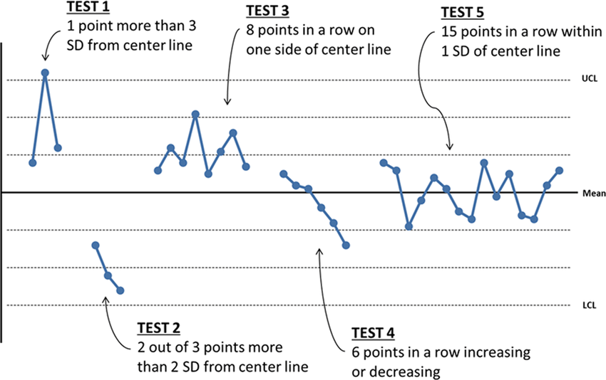
Rules for Detecting Special Cause Variation in Control Charts
Photo by Journal of Perinatology

Slide 5
Tools used, hypothetical data, and scenario:
I used Excel to generate a hypothetical data (for 28 weeks) for the percentage of patients subjected to physical restraints. Range of values I used initially was 3.8% - 51.3% , which I found on a research paper.
I used a ready NHS tool made with Excel QI Macros to create a XmR control chart and set the target to 30%.
Scenario: in order to improve the percentage of patients subjected to physical restraints, we started a 7-week intervention on the 21/03/2023.

Slide 6
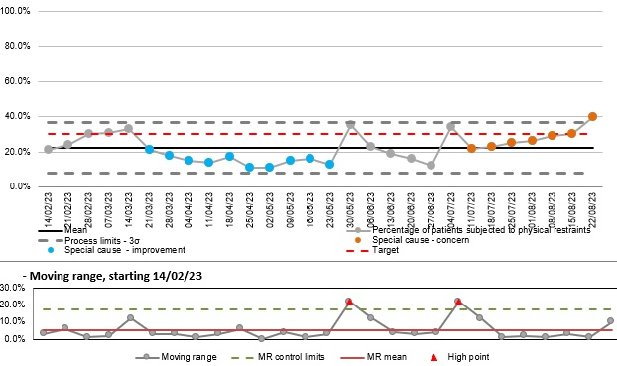
Percentage of Patients Subjected to Physical Restraints (XmR chart)
Physical Restrains

Slide 7
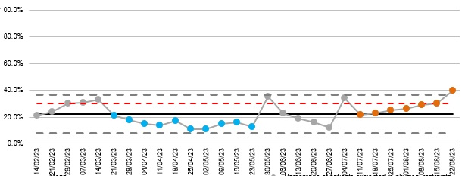
Percentage of Patients Subjected to Physical Restraints (XmR chart)
No Change
Decline
Improvement
Physical Restrains
Upper Control Limit
Centre Line
Lower Control Limit

Slide 8
Summary:
For the purpose of improving the percentage of patients subjected to physical restraints, the intervention started on the 21/03/2023 and lasted 7 weeks. This led to initial improvement.
The process was improving or was stable for 9 weeks, but after that we saw a decline. This is a special cause variation and needs attention.
It looks like some follow-up interventions are required.

Slide 9
Thank you!

